Slide 1
Shell Sort

Slide 2
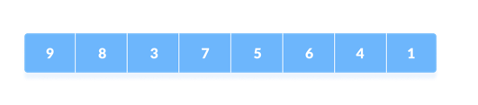
แนวคิด
https://www.programiz.com/dsa/shell-sort

Slide 3
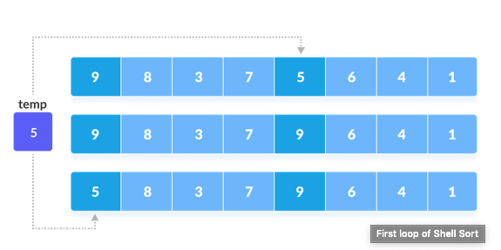
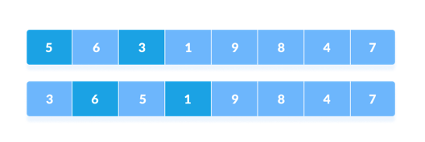
https://www.programiz.com/dsa/shell-sort

Slide 4
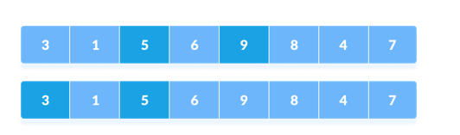
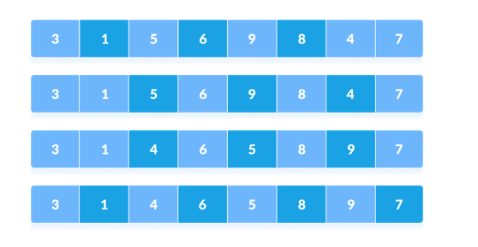
https://www.programiz.com/dsa/shell-sort

Slide 5
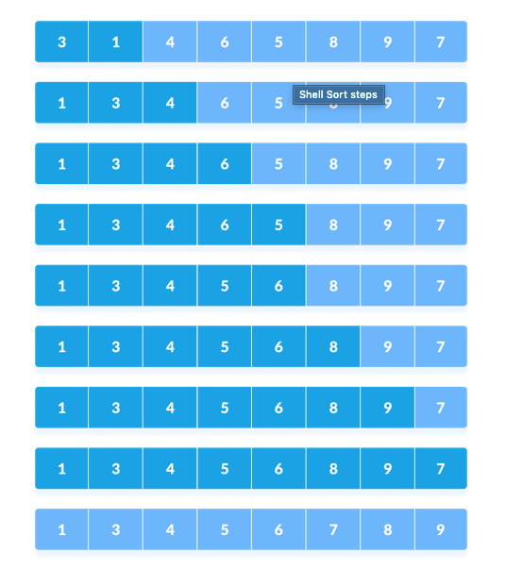
https://www.programiz.com/dsa/shell-sort

Slide 6
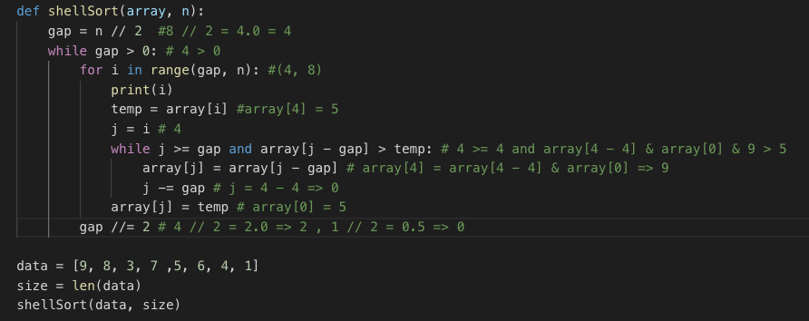
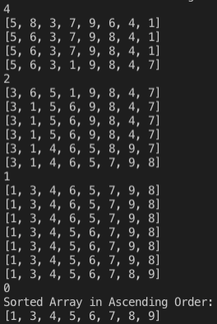
Code

Slide 7
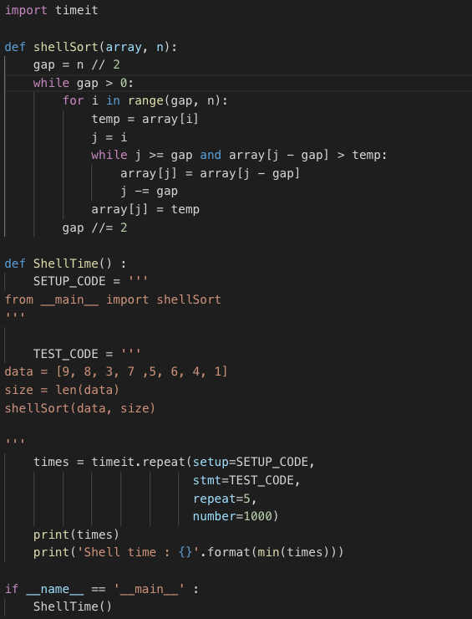
Timeit

Slide 8
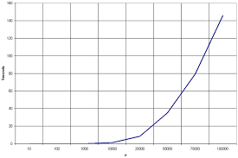
Graph
O(n log n)

Slide 9
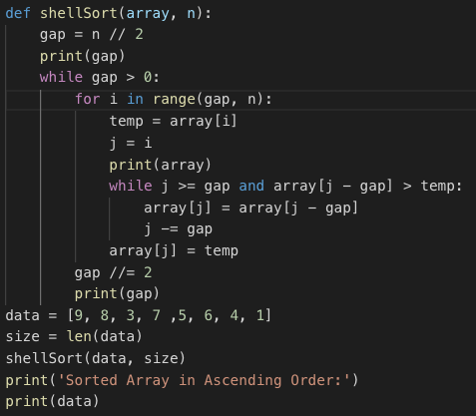
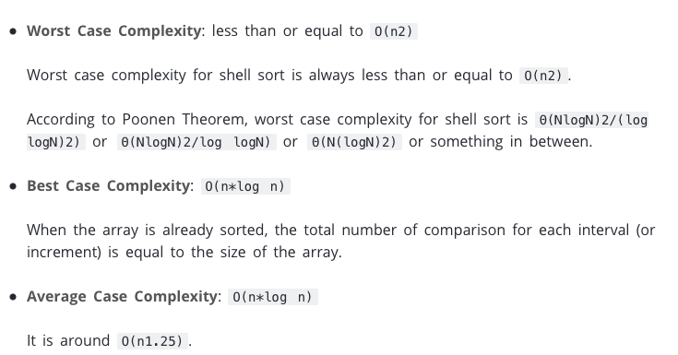
Big O
O (log n)
https://www.programiz.com/dsa/shell-sort

Slide 10
Thank You

